Slide 1


Slide 2


Slide 3
Innovative Project Topic → Analysis of Sales Data of an Ecommerce Company
Submitted to → Mr. Ankit Pramanik & Mr. Sayantan Chakraborty

Slide 4
Name → Sandipan Chowdhury
College → B.P. Poddar Institute of Management and Technology
Course → Computer Science and Engineering, B.Tech.
Session → 2016-2020
Email ID → sandipanchowdhury42@gmail.com
Phone number → 9123972867

Slide 5
Python
Python is an interpreted, high-level, general-purpose programming language. Created by Guido van Rossum and first released in 1991, Python's design philosophy emphasizes code readability with its notable use of significant whitespace. Its language constructs and object-oriented approach aim to help programmers write clear, logical code for small and large-scale projects.
Python is dynamically typed and garbage-collected. It supports multiple programming paradigms, including procedural, object-oriented, and functional programming. Python is often described as a "batteries included" language due to its comprehensive standard library. Libraries such as NumPy, SciPy and Matplotlib allow the effective use of Python in scientific computing, with specialized libraries such as Biopython and Astropy providing domain-specific functionality. Python has been successfully embedded in many software products as a scripting language, including in finite element method software such as Abaqus, 3D parametric modeler like FreeCAD, 3D animation packages such as 3ds Max, Blender, Cinema 4D, Lightwave, Houdini, Maya, modo, MotionBuilder, Softimage, the visual effects compositor Nuke, 2D imaging programs like GIMP, Inkscape, Scribus and Paint Shop Pro, and musical notation programs like scorewriter and capella.

Slide 6
Artificial Intelligence
In computer science, artificial intelligence (AI), sometimes called machine intelligence, is intelligence demonstrated by machines, in contrast to the natural intelligence displayed by humans. Colloquially, the term "artificial intelligence" is often used to describe machines (or computers) that mimic "cognitive" functions that humans associate with the human mind, such as "learning" and "problem solving".
High-profile examples of AI include autonomous vehicles (such as drones and self-driving cars), medical diagnosis, creating art (such as poetry), proving mathematical theorems, playing games (such as Chess or Go), search engines (such as Google search), online assistants (such as Siri), image recognition in photographs, spam filtering, predicting flight delays, prediction of judicial decisions and targeting online advertisements.

Slide 7
Objectives
An Ecommerce Company Snapdeal has many customers across the world. Customers buy products from Snapdeal either by Website or by Smartphone App. Now the company is thinking to decide whether to focus their efforts on either Smartphone App based Sale or Website based Sale, so that their profit is maximum.
With the help of Python and Artificial Intelligence, this innovative project analyses the sales data of Snapdeal Company, and gives an optimized model for the Snapdeal company to take the decision.

Slide 8
Hardware and Softwares
Hardware
Machine → HP BS658TX (Laptop)
RAM Memory → 8 GB
Hard Disk Memory → 1024 GB
Softwares
Operating System → Windows 10 Enterprise (64 bit)
Application Software → Anaconda 3
Programming Language → Python 3.7.3

Slide 9
Code and Output
(Codes are given in black ink. Comments about codes are given in Green ink. Output is given to corresponding input, as a screenshot.)

Slide 10
import pandas as pd ←(Import Pandas)
import seaborn as sns ←(Import Seaborn)
import numpy as np ←(Import Numpy)
import matplotlib.pyplot as plt ←(Import Matplotlib)
sns.set_style('whitegrid') ←(Set Grid Style as White for all Graphs)
%matplotlib inline
SD = pd.read_csv('Snapdeal Dataset.csv') ←(Read the sales data of Snapdeal Company)

Slide 11
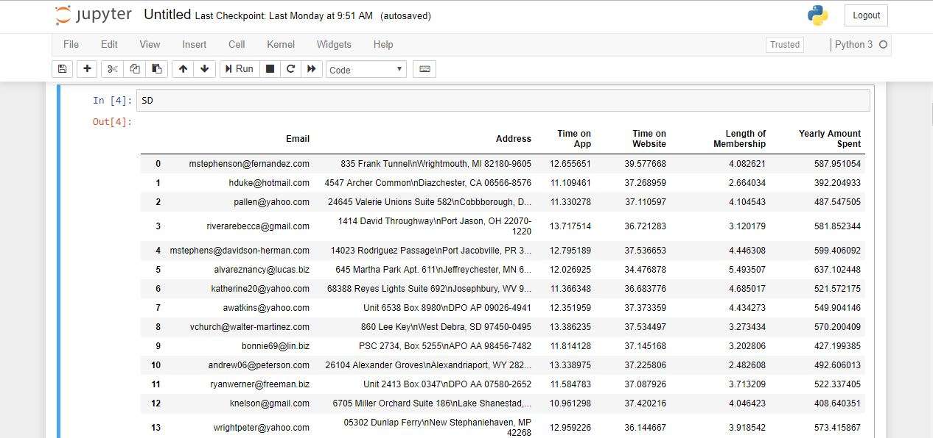
SD ←(Show the SD Dataframe)

Slide 12
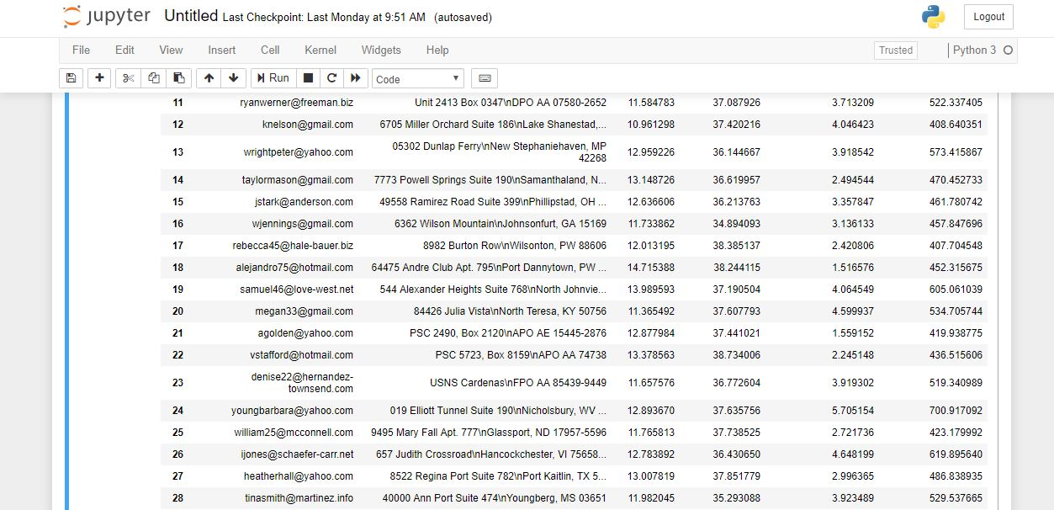

Slide 13
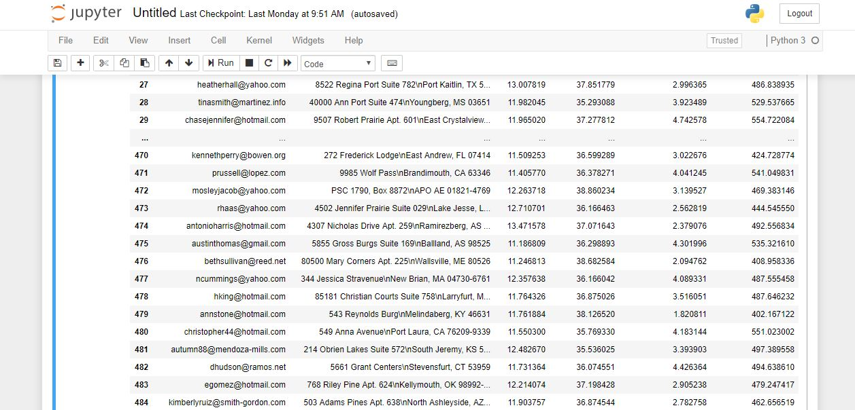

Slide 14
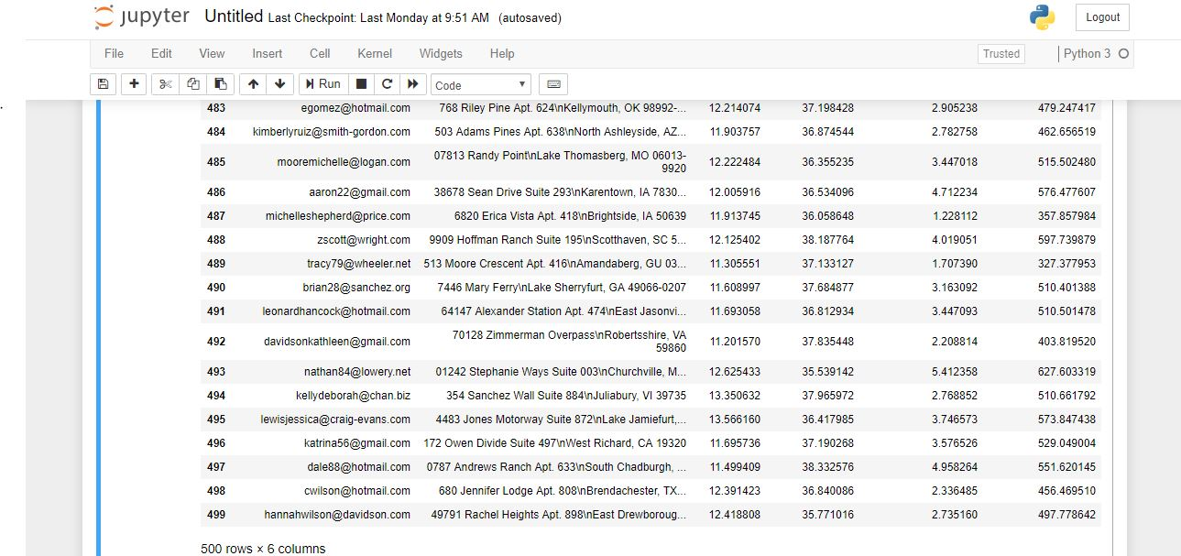

Slide 15
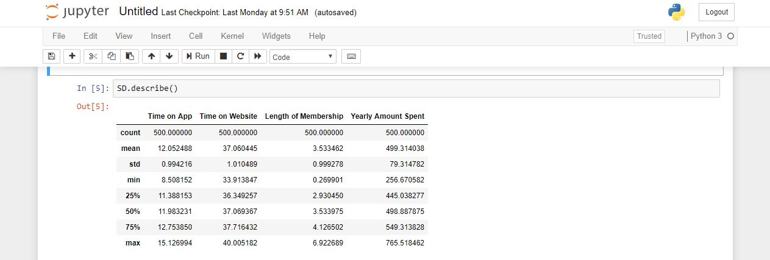
SD.describe( ) ←(Calculate total row wise entries of dataset. Then Calculate Average, Standard Deviation, Minimum value and Maximum value among Column Attributes)

Slide 16
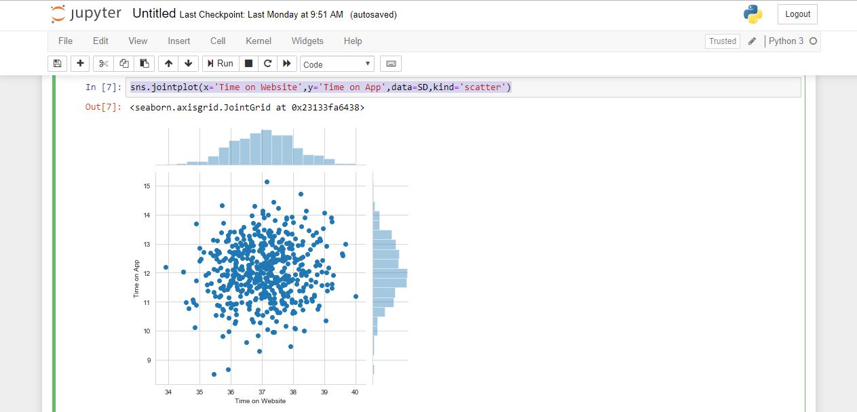
sns.jointplot(x = 'Time on Website', y = 'Time on App', data = SD, kind = 'scatter') ←(Create a 2D Cartesian graph among Time on Website, and Time on App)

Slide 17
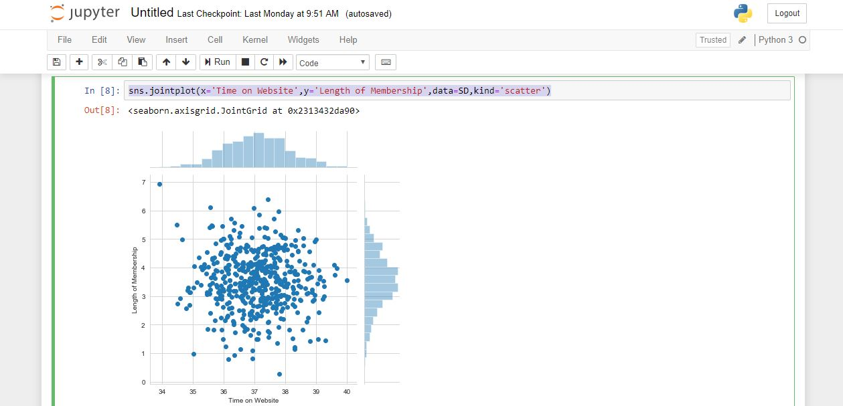
sns.jointplot(x = 'Time on Website', y = 'Length of Membership', data = SD, kind = 'scatter') ←(Create a 2D Cartesian graph among Time on Website, and Length of Membership)

Slide 18
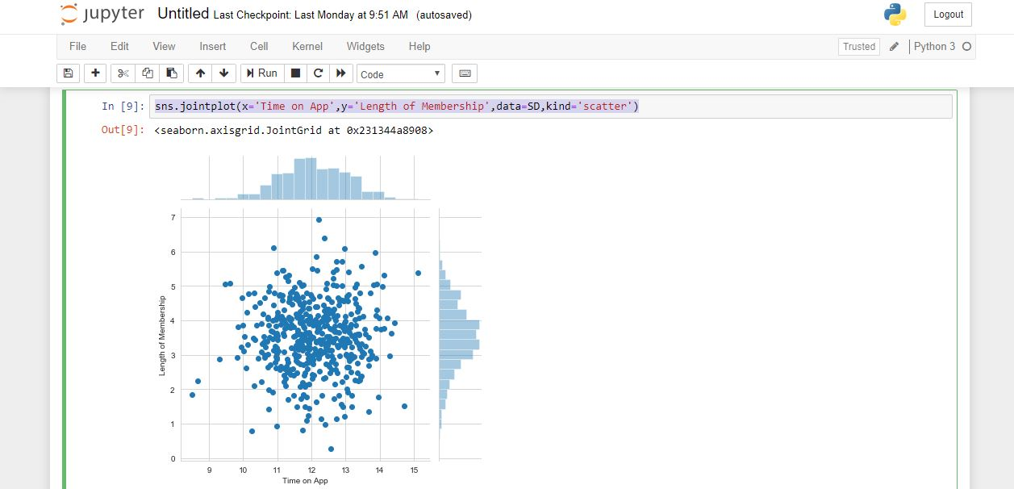
sns.jointplot(x = 'Time on App', y = 'Length of Membership', data = SD, kind = 'scatter') ←(Create a 2D Cartesian graph among Time on App, and Length of Membership)

Slide 19
from sklearn.model_selection import train_test_split ←(Import train_test_split)
X=SD[['Time on App','Time on Website','Length of Membership']]
y=SD['Yearly Amount Spent']
←(Divide the dataset into X and y to train
and test data)
X_train,X_test,y_train,y_test = train_test_split(X, y, test_size=0.5, random_state=200)
←(Define the variables, test size and
random state for training and testing)

Slide 20
from sklearn.linear_model import LinearRegression ←(Import LinearRegression)
lm = LinearRegression() ←( Create an instance of LinearRegression( ) )
lm.fit(X_train,y_train) ←(Fit the dataset for applying Linear Regression Concept)
predictions=lm.predict(X_test) ←(Store the predictive data of X_test in predictions variable)

Slide 21
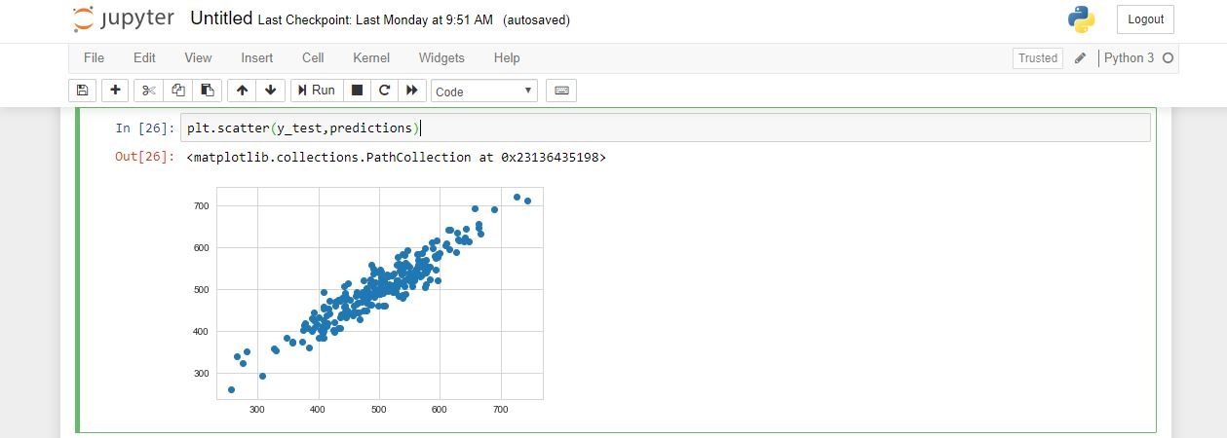
plt.scatter(y_test,predictions) ←(Create 2D Cartesian graph of predictive model)

Slide 22
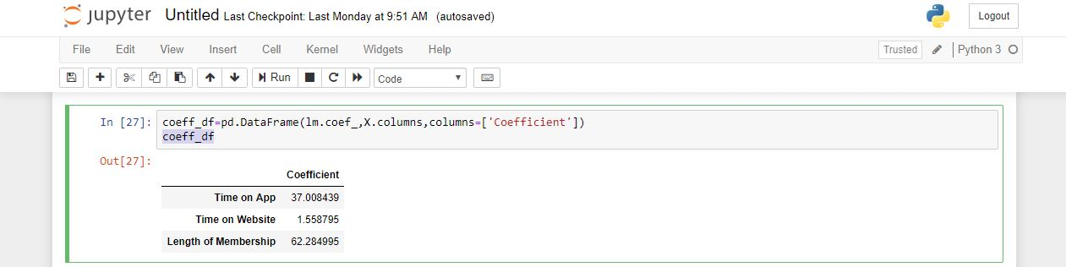
coeff_df = pd.DataFrame(lm.coef_,X.columns,columns=['Coefficient']) ←(Calculate Co efficients of Predictive Model) coeff_df ←(Show the Co efficients of Predictive Model)

Slide 23
Discussion
In this project, at first, let us look on the average values of “Time on App”, “Time on Website”, “Length of Membership” and “Yearly amount spent”. The values are 12.05, 37.06, 3.53, 499.31 simultaneously. So it seems that “Yearly amount spent” is more important, having highest average value. But more analysis of dataset is needed.
Then some 2D Cartesian graphs are plotted among “Time on App”, “Time on Website” and “Length of Membership”.
Then, concept of Artificial Intelligence is applied on dataset by splitting it into training set and testing set. Then a Predictive Model of dataset is built by concept of linear regression. Then a 2D Cartesian graph is plotted of Predictive Model.
All of these 2D graphs suggest that any one thing among “Time on App”, “Time on Website”, and “Length of Membership” needs to be considered.

Slide 24
To take the final decision, the co efficients of “Time on App”, “Time on Website”, and “Length of Membership” are calculated. Now, since the co efficient of “Length of Membership” is highest, so that is considered to be most important.
Python programming language is used in this project; because it is very easy to draw graph and statistical analysis on a database, by python.
Making Predictive Model by training dataset and testing dataset, is a concept of artificial intelligence.
Linear regression is a concept of Statistics.

Slide 25
Conclusion
After analyzing the dataset, it is clear that Length of Membership is most important.
So, Snapdeal Company should concentrate on the Length of Membership of Snapdeal Users, to maximize their profit and to make best business strategies.

Slide 26
Bibliography
https://en.wikipedia.org/wiki/Python_%28programming_language%29
https://en.wikipedia.org/wiki/Artificial_intelligence

